Slide 1
Memory Scheduling in Mixed Criticality Systems
ANKITA SAMADDAR

Slide 2
Outline
Introduction
Related research
Memory bank specification design for mixed criticality system
Row buffer allocation in memory banks
Implementation and Results
References

Slide 3
Mixed Criticality Systems
A mixed-criticality system (MCS) consists of tasks of two or more distinct levels of criticality
Allows execution of the same task with different budgets
Useful in resource constrained environments
Configurability and flexibility becoming more and more important in the current context
Examples - automobile systems, avionics systems etc.
Challenges in MCS design:
Allocate resources to a heterogeneous set of tasks to ensure fairness
Meet task deadlines and ensure system safety
Increase the number of critical task execution

Slide 4
Motivation and objectives of this dissertation
Study the suitability of contemporary architectures for execution of mixed criticality tasks
CPU scheduling has been well researched in literature
Effect of memory scheduling has been relatively less studied
Objective of this dissertation
Are current memory DRAM architectures good enough?
How does memory scheduling policies affect criticality execution?
Identify bottlenecks in contemporary memory architectures and propose solutions

Slide 5
Some related research
A predictable and command-level priority-based dram controller for mixed-criticality systems [1]
Deals with the idea of Memory Access Group (MAG) with one safety critical and two or more critical tasks
Disadvantage: Many safety critical tasks may miss their deadlines when they are in large numbers compared to the number of tasks of lower criticality level
A new pseudo-boolean satisfiability based approach to power mode schedulability analysis [2]
Deals with the schedulability of tasks based on the power mode partitioning problem
This is the main motivation of our problem
To the best of our knowledge, ours is the first to study the bank specification design problem

Slide 6
Contributions of this dissertation
The bank specification design problem for hosting a set of mixed criticality tasks
Given a set of mixed criticality tasks and a memory structure with a given number of banks that allows interleaving:
Is it possible to meet all task deadlines?
Maximum set of tasks that can be hosted
Minimum number of banks needed
Hardness results
Constraint formulations
Extensive experiments
The row buffer locality problem and MCS execution
Given a schedule of MCS execution, do current DRAM architectures maintain the schedule?
Findings about bank row buffer locality
Hardness result
Heuristic approach
Experiments on public domain benchmarks

Slide 7
Contributions of this dissertation
The bank specification design problem for hosting a set of mixed criticality tasks
Given a set of mixed criticality tasks and a memory structure with a given number of banks that allows interleaving:
Is it possible to meet all task deadlines?
Maximum set of tasks that can be hosted
Minimum number of banks needed
Hardness results
Constraint formulations
Extensive experiments

Slide 8
Mixed Criticality Systems: Formal Model
A mixed critical task Ʈ_{i} = (A_{i} , D_{i}, C_{i}, E_{i}^{j} )
A_{i} ∈ N denotes the arrival time,
D_{i} ∈ N and D_{i} > A_{i} denotes the deadline,
C_{i} denotes the set of criticality levels,
E_{i}^{j} ∈ R denotes its execution time / memory budget at j^{th} criticality level
Problem definition: Given a set of mixed criticality tasks with individual deadlines, and a DRAM structure with a given number of banks that allows interleaving:
Is it possible to meet all task deadlines?

Slide 9
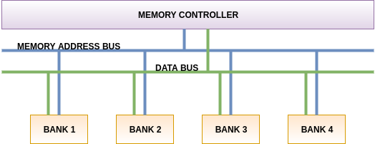
DRAM Organisation today
Common Memory Address Bus
Common Data Bus
Bank Interleaving (computation in the banks can run in parallel)

Slide 10
Bank specification design of a MCS
i^{th} task in MCS can be defined as Ʈ_{i} = (L_{i}, B_{i}, E_{i}, D_{i})
L_{i} ∈ Z⁺ , denoting j criticality levels which task τ _{i} can exibit
B _{i} : L_{i} → N, B_{i} denotes the number of banks (parallel memory bank access) that τ_{i} exhibits at each criticality level in L_{i}
E_{i} : L_{i} → R, E_{i} denotes the percentage of total task that can be completed by τ_{i} at each criticality level in L_{i} .
D_{i} ∈ Z⁺, denotes the deadline of i^{th} task τ_{i}
A single task can be made to execute in different criticality levels in different cycles
The number of banks required at the respective criticality levels need to be provided for parallel access
The final cumulative execution must reach 100% for task completion within deadline

Slide 11
Motivating Example
Consider the following MCS task-set and a DRAM memory structure with 12 banks
No possible execution scheduling that can meet all deadlines
Minimum number of banks required is 15
TASK ID | Criticality Levels | Parallel Bank Access | % of task executed | Deadline
1 | {L1,L2,L3} | L1 - 6 L2 - 10 L3 - 0 | L1 - 25% L2 - 35% L3 - 0% | 4 cycles
2 | {L1,L2,L3} | L1 - 5 L2 - 10 L3 - 0 | L1 - 20% L2 - 30% L3 - 0% | 5 cycles
3 | {L1,L2,L3,L4} | L1 - 0 L2 - 4 L3 - 8 L4 - 12 | L1 - 0% L2 - 15% L3 - 25% L4 - 40% | 6 cycles
Designer’s challenge:
Determine if the given task set can be hosted on the available bank structure
If not, what is the minimum number of banks needed?
If the system is not reconfigurable, what is the maximum number of tasks and what is the schedule for task execution?

Slide 12
Hardness Characterisation of the problem
Decision Problem - Given a set of mixed critical tasks with different deadlines and with different memory requirements at different criticality levels, the problem is to determine if the set of tasks can be served with a given number of memory banks such that all tasks finish execution within their deadlines.
Our finding: the problem is NP complete
Given a schedule, can be verified in polynomial time
Hardness: Reduction from SET Partitioning problem
Detailed in dissertation

Slide 13
Constraint Formulation
Decision variable
f_{ijk} = 1, if i^{th} task is scheduled to execute at the j^{th} criticality level in the k^{th} cycle
= 0, otherwise
In every cycle a task will execute in exactly one of its criticality levels.
_{|Li|}
for each task , ∑ f_{ijk} = 1, ∀k, 1 ≤ k ≤ D_{i}
^{j=1}
A task must complete 100% of its execution before its deadline.
_{|Li| |Di|}
∑ ∑ E_{i}(L_{ij}) * f_{ijk} ≥100, ∀i, 1 ≤ i ≤ n
^{j=1 k=1}
At any cycle the total number of banks ≤ z (the number of banks available to the system)
_{n} _{|Li|}
∑ ∑ B_{i}(L_{ij}) * f_{ijk} ≤ z , ∀k, 1 ≤ k ≤ D_{i}
^{i=1 j=1}

Slide 14
Constraint Formulation
Given the set of constraints:
A solution assigns 0 / 1 values to the f_{ijk} variables
The solution helps in constructing the schedule for task execution
Assigns individual tasks to individual criticality levels at each cycle
For the given example
A memory with 12 banks fails to schedule the above tasks within their deadline
A memory with 15 banks suffices
No cycle uses more than 15 banks
All tasks finish by their deadline

Slide 15
Related Questions
The maximum number of tasks that can be scheduled to complete by their deadlines, with the given number of banks
The minimum number of banks required to schedule a given set of tasks
Both are NP-hard
Reductions from set partitioning and its variants
Similar constraint formulations as the decision variant

Slide 16
Constraint Formulation for bank minimization
Similar model as the decision variant, with an objective function
Minimize z such that:
In every cycle a task will execute in exactly one of its criticality levels.
_{|Li|}
for each task , ∑ f_{ijk} = 1, ∀k, 1 ≤ k ≤ D_{i}
^{j=1}
A task must complete 100% of its execution before its deadline.
_{|Li| |Di|}
∑ ∑ E_{i}(L_{ij}) * f_{ijk} ≥100, ∀i, 1 ≤ i ≤ n
^{j=1 k=1}
At any cycle, the total number of banks ≤ z (the number of banks available to the system)
_{n} _{|Li|}
∑ ∑ B_{i}(L_{ij}) * f_{ijk} ≤ z , ∀k, 1 ≤ k ≤ D_{i}
^{i=1 j=1}

Slide 17
Discussions on the ILP solution
Does not scale beyond a limit
Search space traversal based on heuristics inside the solver
New approach:
Systematically reduce the search space using binary search
Start from the maximum number of banks and iterate
Leads to drastic reduction of search space as compared to ILP approach
Details in experiments

Slide 18
Applying Binary Search for Bank Minimisation
Idea
min = 1
_{| T |}
max = ∑ max(no of banks required by T_{i})
^{i = 1}
while min < max
mid = (min + max)/2
check if there is a solution at n = mid
if "yes", then max = mid
else min = mid + 1
return mid

Slide 19
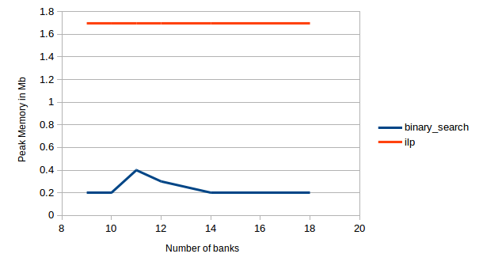
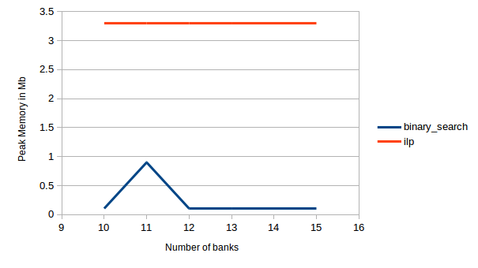
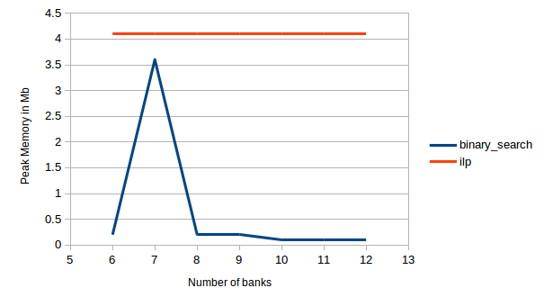
Results on the peak memory consumed by ILP vs Binary Search for different tasksets

Slide 20
Contributions of this dissertation
The row buffer locality problem with MCS execution
Given a schedule of MCS execution, do current DRAM architectures maintain the schedule?
Findings about bank row buffer locality
Hardness result
Heuristic approach
Experiments on public domain benchmarks
We consider a task consisting of a mix of CPU and memory requests
CPU requests served by the CPU as per its scheduling policy (e.g. EDF / FCFS..)
We examine the memory requests only

Slide 21
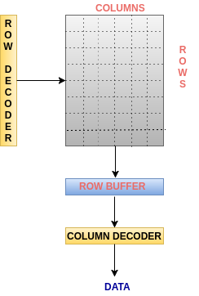
DRAM Bank Organisation
Inside a memory bank, there are memory devices consisting of rows and columns
Each memory address corresponds to a cell in the memory device
Each memory access is associated with a memory address
The row corresponding to the cell in the memory address is brought in the row buffer and the memory operations are done at the appropriate column in the row buffer

Slide 22
DRAM controllers
Memory requests scheduled for DRAM access by the DRAM controller
Current controllers take the advantage of the row buffer
A row conflict memory request takes significantly longer access than a row hit access
Most commonly used scheduling policy (FR-FCFS) [3]
Row hit (column) first : Service row hit memory
Oldest first : Then service older first

Slide 23
FR-FCFS policy
R
O
W
D
E
C
O
D
E
R
Consider a set of requests from two applications
Application 1
ROW 0, COLUMN 0
ROW 0, COLUMN 1
ROW 0, COLUMN 2
ROW 1, COLUMN 1
ROW 1, COLUMN 2
Application 2
ROW 1, COLUMN 5
ROW 2, COLUMN 3
ROW 5, COLUMN 1
ROW 7, COLUMN 2
ROW BUFFER
COLUMN DECODER
DATA

Slide 24
FR-FCFS policy
R
O
W
D
E
C
O
D
E
R
Consider a set of requests from two applications
Application 1
ROW 0, COLUMN 0
ROW 0, COLUMN 1
ROW 0, COLUMN 2
ROW 1, COLUMN 1
ROW 1, COLUMN 2
Application 2
ROW 1, COLUMN 5
ROW 2, COLUMN 3
ROW 5, COLUMN 1
ROW 7, COLUMN 2
ROW 0,
COLUMN 0
ROW 0
ROW BUFFER
COLUMN DECODER
DATA

Slide 25
FR-FCFS policy
R
O
W
D
E
C
O
D
E
R
Consider a set of requests from two applications
Application 1
ROW 0, COLUMN 0
ROW 0, COLUMN 1
ROW 0, COLUMN 2
ROW 1, COLUMN 1
ROW 1, COLUMN 2
Application 2
ROW 1, COLUMN 5
ROW 2, COLUMN 3
ROW 5, COLUMN 1
ROW 7, COLUMN 2
ROW 0,
COLUMN 0
ROW 0
ROW BUFFER
COLUMN DECODER
DATA

Slide 26
FR-FCFS policy
R
O
W
D
E
C
O
D
E
R
Consider a set of requests from two applications
Application 1
ROW 0, COLUMN 0
ROW 0, COLUMN 1
ROW 0, COLUMN 2
ROW 1, COLUMN 1
ROW 1, COLUMN 2
Application 2
ROW 1, COLUMN 5
ROW 2, COLUMN 3
ROW 5, COLUMN 1
ROW 7, COLUMN 2
ROW 0,
COLUMN 0
ROW 0
ROW BUFFER
COLUMN 0
COLUMN DECODER
DATA

Slide 27
FR-FCFS policy
R
O
W
D
E
C
O
D
E
R
Consider a set of requests from two applications
Application 1
ROW 0, COLUMN 0
ROW 0, COLUMN 1
ROW 0, COLUMN 2
ROW 1, COLUMN 1
ROW 1, COLUMN 2
Application 2
ROW 1, COLUMN 5
ROW 2, COLUMN 3
ROW 5, COLUMN 1
ROW 7, COLUMN 2
ROW 0,
COLUMN 1
ROW 0
ROW BUFFER
COLUMN DECODER
DATA

Slide 28
FR-FCFS policy
R
O
W
D
E
C
O
D
E
R
Consider a set of requests from two applications
Application 1
ROW 0, COLUMN 0
ROW 0, COLUMN 1
ROW 0, COLUMN 2
ROW 1, COLUMN 1
ROW 1, COLUMN 2
Application 2
ROW 1, COLUMN 5
ROW 2, COLUMN 3
ROW 5, COLUMN 1
ROW 7, COLUMN 2
ROW 0,
COLUMN 1
ROW 0
ROW BUFFER
COLUMN DECODER
DATA

Slide 29
FR-FCFS policy
R
O
W
D
E
C
O
D
E
R
Consider a set of requests from two applications
Application 1
ROW 0, COLUMN 0
ROW 0, COLUMN 1
ROW 0, COLUMN 2
ROW 1, COLUMN 1
ROW 1, COLUMN 2
Application 2
ROW 1, COLUMN 5
ROW 2, COLUMN 3
ROW 5, COLUMN 1
ROW 7, COLUMN 2
ROW 0,
COLUMN 1
ROW 0
ROW BUFFER
COLUMN 1
COLUMN DECODER
DATA

Slide 30
FR-FCFS policy
R
O
W
D
E
C
O
D
E
R
Consider a set of requests from two applications
Application 1
ROW 0, COLUMN 0
ROW 0, COLUMN 1
ROW 0, COLUMN 2
ROW 1, COLUMN 1
ROW 1, COLUMN 2
Application 2
ROW 1, COLUMN 5
ROW 2, COLUMN 3
ROW 5, COLUMN 1
ROW 7, COLUMN 2
ROW 0,
COLUMN 2
ROW 0
ROW BUFFER
COLUMN DECODER
DATA

Slide 31
FR-FCFS policy
R
O
W
D
E
C
O
D
E
R
Consider a set of requests from two applications
Application 1
ROW 0, COLUMN 0
ROW 0, COLUMN 1
ROW 0, COLUMN 2
ROW 1, COLUMN 1
ROW 1, COLUMN 2
Application 2
ROW 1, COLUMN 5
ROW 2, COLUMN 3
ROW 5, COLUMN 1
ROW 7, COLUMN 2
ROW 0,
COLUMN 2
ROW 0
ROW BUFFER
COLUMN 2
COLUMN DECODER
DATA

Slide 32
FR-FCFS policy
R
O
W
D
E
C
O
D
E
R
Consider a set of requests from two applications
Application 1
ROW 0, COLUMN 0
ROW 0, COLUMN 1
ROW 0, COLUMN 2
ROW 1, COLUMN 1
ROW 1, COLUMN 2
Application 2
ROW 1, COLUMN 5
ROW 2, COLUMN 3
ROW 5, COLUMN 1
ROW 7, COLUMN 2
ROW 1,
COLUMN 5
ROW 1
ROW BUFFER
COLUMN 5
COLUMN DECODER
DATA

Slide 33
FR-FCFS policy
R
O
W
D
E
C
O
D
E
R
Consider a set of requests from two applications
Application 1
ROW 0, COLUMN 0
ROW 0, COLUMN 1
ROW 0, COLUMN 2
ROW 1, COLUMN 1
ROW 1, COLUMN 2
Application 2
ROW 1, COLUMN 5
ROW 2, COLUMN 3
ROW 5, COLUMN 1
ROW 7, COLUMN 2
ROW 1,
COLUMN 5
ROW 1
ROW BUFFER
COLUMN 5
COLUMN DECODER
DATA

Slide 34
FR-FCFS policy
R
O
W
D
E
C
O
D
E
R
Consider a set of requests from two applications
Application 1
ROW 0, COLUMN 0
ROW 0, COLUMN 1
ROW 0, COLUMN 2
ROW 1, COLUMN 1
ROW 1, COLUMN 2
Application 2
ROW 1, COLUMN 5
ROW 2, COLUMN 3
ROW 5, COLUMN 1
ROW 7, COLUMN 2
ROW 1,
COLUMN 1
ROW 1
ROW BUFFER
COLUMN 1
COLUMN DECODER
DATA

Slide 35
FR-FCFS policy
R
O
W
D
E
C
O
D
E
R
Consider a set of requests from two applications
Application 1
ROW 0, COLUMN 0
ROW 0, COLUMN 1
ROW 0, COLUMN 2
ROW 1, COLUMN 1
ROW 1, COLUMN 2
Application 2
ROW 1, COLUMN 5
ROW 2, COLUMN 3
ROW 5, COLUMN 1
ROW 7, COLUMN 2
ROW 1,
COLUMN 2
ROW 1
ROW BUFFER
COLUMN 2
COLUMN DECODER
DATA

Slide 36
Memory Bank scheduling
Parallel bank access not always the case
After address translation, two or more addresses may get mapped to same bank
FR-FCFS policy may create issues
EDF-based approach followed by CPU breaks when it encounters memory
May lead to deadline violations
Motivation of our second problem

Slide 37
Hardness Characterisation of the problem
Given a set of n memory requests (M1, M2, M3 . . . Mn) coming from a set of k tasks having different deadlines (D1, D2, . . . Dk), executing on a memory with m banks. Can we schedule n memory requests on m banks over T cycles based on the address to which they are mapped so that all k tasks can meet their deadlines.
Our finding: The problem is NP complete
Hardness reduction from CNF Satisfiability
Details in dissertation

Slide 38
Proposed heuristic Main idea
Keep a set of reserved banks
Model the task memory access requests as a network
Start with an initial request to bank assignment according to the addresses as usual
Evaluate the number of deadlines missed
Adjust the partition iteratively moving some accesses to the reserved banks
Involves cloning the memory
Iterative heuristic for partitioning the network as long as deadline misses reduces [Gain computation]
Worst case computation time per pass grows linearly with size of the network [4]

Slide 39
Idea of our proposed heuristic
n : optimal number of memory banks for a set of mixed critical tasks
Reserve 2 extra banks which do not participate in address mapping
Gain(Req_{i}) = Gain(serving a request in the same bank) - Gain(serving the request in any one of the reserved banks)
Gain(Req_{i}) = [T.deadline - (total memory access time + total waiting time in existing method)] - [T.deadline - (total memory access time + total waiting time in our method)]
if Gain(Req_{i}) > 0, serve Req_{i} in the same bank
otherwise, serve Req_{i} in any one of the reserved banks

Slide 40
Our proposed algorithm
Input - Request <Memory address, Request type>, deadline of the task, number of parallel accesses remaining
Output - Bank to which the Request gets mapped

Slide 41
Our Algorithm with the help of an example
Consider we have 2 banks and 1 reserved bank with 8 rows in each bank.
BANK 0 | BANK 1 | RESERVED BANK
T0 (deadline = 6 cycles) | T1 (deadline = 10 cycles)
R00 - ROW 0, COLUMN 0 R01 - ROW 1, COLUMN 3 R02 - ROW 2, COLUMN 6 | R10 - ROW 2, COLUMN 1 R11 - ROW 1, COLUMN 2 R12 - ROW 9, COLUMN 5 R13 - ROW 7, COLUMN 4
Let
row hit - 1 cycle
row miss - 2 cycle
time for executing request in some other bank when row miss - 3 cycles

Slide 42
Our Algorithm with the help of an example
Cycle 1
Step 1: R00 -> BANK 0, R12 -> BANK 1
BANK 0 | BANK 1 | RESERVED BANK
ROW 0 | ROW 9 | ROW 1
T0 (deadline = 6 cycles) | T1 (deadline = 10 cycles)
R00 - ROW 0, COLUMN 0 R01 - ROW 1, COLUMN 3 R02 - ROW 2, COLUMN 6 | R10 - ROW 2, COLUMN 1 R11 - ROW 1, COLUMN 2 R12 - ROW 9, COLUMN 5 R13 - ROW 7, COLUMN 4
Let
row hit - 1 cycle
row miss - 2 cycle
time for executing request in some other bank when row miss - 3 cycles

Slide 43
Our Algorithm with the help of an example
Cycle 1
Step 2: R00 -> BANK 0, R12 -> BANK 1
Gain1(R01) = 6 - 2 - 2 - 2 = 0
Gain2(R01) = 6 - 3 - 2 = 1
R01 gets executed in the RESERVED BANK
BANK 0 | BANK 1 | RESERVED BANK
ROW 0 | ROW 9 | ROW 1
T0 (deadline = 6 cycles) | T1(deadline = 10 cycles)
R00 - ROW 0, COLUMN 0 R01 - ROW 1, COLUMN 3 R02 - ROW 2, COLUMN 6 | R10 - ROW 2, COLUMN 1 R11 - ROW 1, COLUMN 2 R12 - ROW 9, COLUMN 5 R13 - ROW 7, COLUMN 4
Let
row hit - 1 cycle
row miss - 2 cycle
time for executing request in some other bank when row miss - 3 cycles

Slide 44
Our Algorithm with the help of an example
Cycle 2
BANK 0, BANK 1, RESERVED BANK are busy
BANK 0 | BANK 1 | RESERVED BANK
ROW 0 | ROW 9 | ROW 1
T0 (deadline = 6 cycles) | T1(deadline = 10 cycles)
R00 - ROW 0, COLUMN 0 R01 - ROW 1, COLUMN 3 R02 - ROW 2, COLUMN 6 | R10 - ROW 2, COLUMN 1 R11 - ROW 1, COLUMN 2 R12 - ROW 9, COLUMN 5 R13 - ROW 7, COLUMN 4
Let
row hit - 1 cycle
row miss - 2 cycle
time for executing request in some other bank when row miss - 3 cycles

Slide 45
Our Algorithm with the help of an example
Cycle 3
RESERVED BANK is busy, BANK 0 and BANK 1 are free
BANK 0 | BANK 1 | RESERVED BANK
ROW 0 | ROW 9 | ROW 1
T0 (deadline = 6 cycles) | T1(deadline = 10 cycles)
R01 - ROW 1, COLUMN 3 R02 - ROW 2, COLUMN 6 | R10 - ROW 2, COLUMN 1 R11 - ROW 1, COLUMN 2 R13 - ROW 7, COLUMN 4
Let
row hit - 1 cycle
row miss - 2 cycle
time for executing request in some other bank when row miss - 3 cycles

Slide 46
Our Algorithm with the help of an example
Cycle 3
Step 3: Waiting time (R02) = 2 cycles
Gain1(R02) = 6 - 2 - 2 = 2
Gain2(R02) = 6 - 2 - 3 = 1
R02 gets executed in BANK 0
BANK 0 | BANK 1 | RESERVED BANK
ROW 2 | ROW 9 | ROW 1
T0 (deadline = 6 cycles) | T1(deadline = 10 cycles)
R01 - ROW 1, COLUMN 3 R02 - ROW 2, COLUMN 6 | R10 - ROW 2, COLUMN 1 R11 - ROW 1, COLUMN 2 R13 - ROW 7, COLUMN 4
Let
row hit - 1 cycle
row miss - 2 cycle
time for executing request in some other bank when row miss - 3 cycles

Slide 47
Our Algorithm with the help of an example
Cycle 4
RESERVED BANK is free, BANK 0 is busy, BANK 1 is free
BANK 0 | BANK 1 | RESERVED BANK
ROW 2 | ROW 9 | ROW 1
T0 (deadline = 6 cycles) | T1(deadline = 10 cycles)
R02 - ROW 2, COLUMN 6 | R10 - ROW 2, COLUMN 1 R11 - ROW 1, COLUMN 2 R13 - ROW 7, COLUMN 4
Let
row hit - 1 cycle
row miss - 2 cycle
time for executing request in some other bank when row miss - 3 cycles

Slide 48
Our Algorithm with the help of an example
Cycle 4
Step 4: Waiting time (R10) = 3 cycles
Gain1(R10) = 10 - 3 - 1 - 1 - 3*2 = -1
Gain2(R10) = 10 - 3 - 3 - 3*2 = -2
Waiting time (R11) = 3 cycles
Gain1(R11) = 10 - 3 - 1 - 2 - 2*2 = 0
Gain2(R11) = 10 - 3 - 1 - 2*2 = 2
R11 gets executed in RESERVED BANK
BANK 0 | BANK 1 | RESERVED BANK
ROW 2 | ROW 9 | ROW 1
T0 (deadline = 6 cycles) | T1(deadline = 10 cycles)
R02 - ROW 2, COLUMN 6 | R10 - ROW 2, COLUMN 1 R11 - ROW 1, COLUMN 2 R13 - ROW 7, COLUMN 4
Let
row hit - 1 cycle
row miss - 2 cycle
time for executing request in some other bank when row miss - 3 cycles

Slide 49
Our Algorithm with the help of an example
Cycle 5
BANK 0 is free, BANK 1 is free, RESERVED BANK is free
T0 completed before deadline
BANK 0 | BANK 1 | RESERVED BANK
ROW 2 | ROW 9 | ROW 1
T0 (deadline = 6 cycles) | T1(deadline = 10 cycles)
 | R10 - ROW 2, COLUMN 1 R13 - ROW 7, COLUMN 4
Let
row hit - 1 cycle
row miss - 2 cycle
time for executing request in some other bank when row miss - 3 cycles

Slide 50
Our Algorithm with the help of an example
Cycle 5
Step 5: Waiting time (R10) = 4
Gain1(R10) = 10 - 4 - 1 - 3*2 = -1
Gain2(R10) = 10 - 4 - 3 - 3*2 = -2
R10 gets executed in BANK 0
Waiting time (R13) = 4
Gain1(R13) = 10 - 4 - 1 - 2 = 3
Gain2(R13) = 10 - 4 - 3 = 3
BANK 0 | BANK 1 | RESERVED BANK
ROW 2 | ROW 9 | ROW 1
T0 (deadline = 6 cycles) | T1(deadline = 10 cycles)
 | R10 - ROW 2, COLUMN 1 R13 - ROW 7, COLUMN 4
Let
row hit - 1 cycle
row miss - 2 cycle
time for executing request in some other bank when row miss - 3 cycles

Slide 51
Our Algorithm with the help of an example
Cycle 6
RESERVED BANK is free, BANK 0 is free, BANK 1 is free
BANK 0 | BANK 1 | RESERVED BANK
ROW 2 | ROW 9 | ROW 1
T0 (deadline = 6 cycles) | T1(deadline = 10 cycles)
 | R13 - ROW 7, COLUMN 4
Let
row hit - 1 cycle
row miss - 2 cycle
time for executing request in some other bank when row miss - 3 cycles

Slide 52
Our Algorithm with the help of an example
Cycle 6
Step 6: Waiting time (R13) = 5
Gain1(R13) = 10 - 5 - 2 =3
Gain2(R13) = 10 - 5 - 3 = 2
R13 gets executed in BANK 0
BANK 0 | BANK 1 | RESERVED BANK
ROW 7 | ROW 9 | ROW 1
T0 (deadline = 6 cycles) | T1(deadline = 10 cycles)
 | R13 - ROW 7, COLUMN 4
Let
row hit - 1 cycle
row miss - 2 cycle
time for executing request in some other bank when row miss - 3 cycles

Slide 53
Our Algorithm with the help of an example
Cycle 7
BANK 0 is busy, BANK 1 is free, RESERVED BANK is free
BANK 0 | BANK 1 | RESERVED BANK
ROW 7 | ROW 9 | ROW 1
T0 (deadline = 6 cycles) | T1(deadline = 10 cycles)
 | R13 - ROW 7, COLUMN 4
Let
row hit - 1 cycle
row miss - 2 cycle
time for executing request in some other bank when row miss - 3 cycles

Slide 54
Our Algorithm with the help of an example
Cycle 8
All Banks are free
T0 and T1 are completed before deadline
BANK 0 | BANK 1 | RESERVED BANK
ROW 7 | ROW 9 | ROW 1
T0 (deadline = 6 cycles) | T1(deadline = 10 cycles)
Let
row hit - 1 cycle
row miss - 2 cycle
time for executing request in some other bank when row miss - 3 cycles

Slide 55
Implementation and Results
Implemented our own memory simulator for mixed criticality systems
Generated memory traces from Malardalen Worst Case Execution Time Benchmark programs [5]
Compared our results on normal DRAM controller which follows FR-FCFS policy vs our DRAM controller on varying sizes of memory banks with different row buffer sizes
We have generated our results by running our traces on different tasksets upto 70,000 cycles

Slide 56
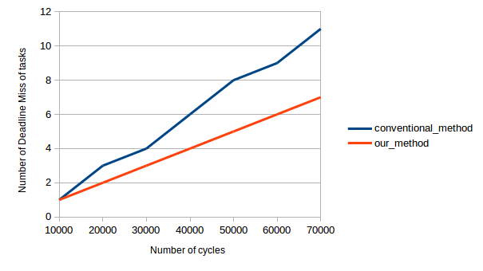
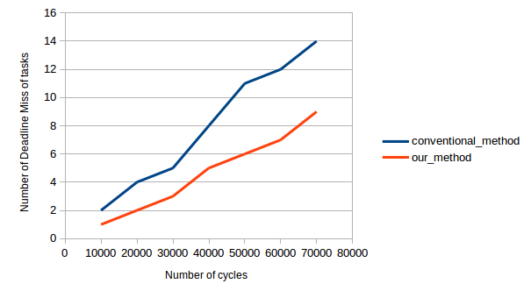
Implementation and Results

Slide 57
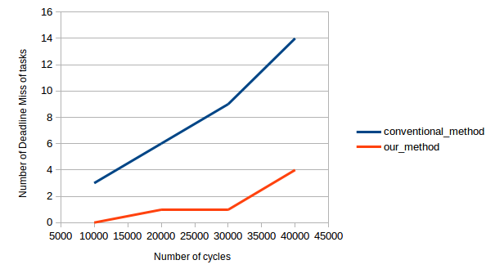
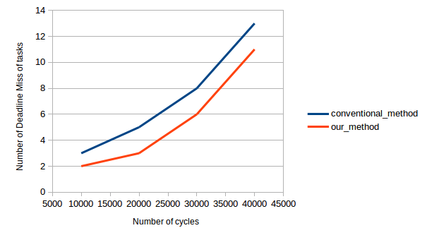
Implementation and Results

Slide 58
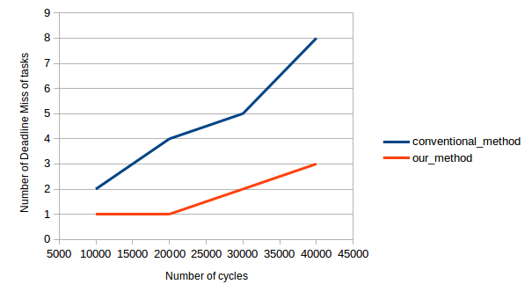
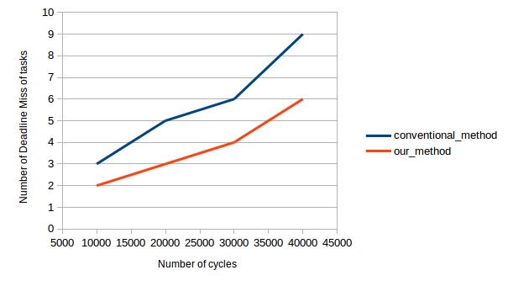
Implementation and Results

Slide 59
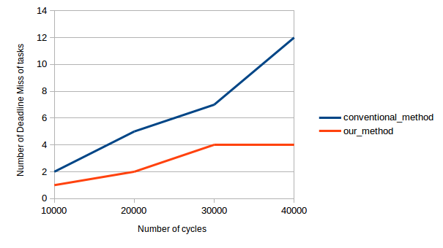
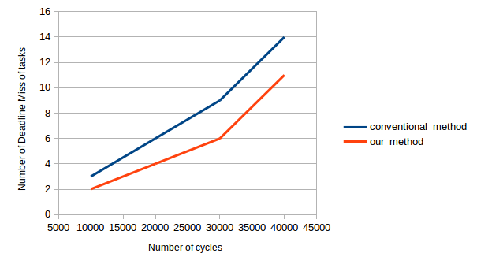
Implementation and Results

Slide 60
Conclusion and Future work
We address the problem of memory scheduling in mixed criticality systems
Explore the problem from the memory scheduling perspective and the row buffer organization
Experimental results are encouraging
As future work, we wish to explore the same problem in the context of new memory architectures

Slide 61
References
Kim, H., Broman, D., Lee, E. A., Zimmer, M., Shrivastava, A., and Oh, J. A predictable and command-level priority-based dram controller for mixed-criticality systems. In Real-Time and Embedded Technology and Applications Symposium (RTAS), 2015 IEEE (2015), IEEE, pp. 317–326.
Ray, S., Dasgupta, P., and Chakrabarti, P. P. A new pseudo-boolean satisfiability based approach to power mode schedulability analysis. In 20th International Conference on VLSI Design (VLSI Design 2007), Sixth International Conference on Embedded Systems (ICES 2007), 6-10 January 2007, Bangalore, India (2007),pp. 95–102.
Rixner, Scott, et al. "Memory access scheduling." ACM SIGARCH Computer Architecture News. Vol. 28. No. 2. ACM, 2000.
Fiduccia, C. M., and Mattheyses, R. M. A linear-time heuristic for improving network partitions. In Papers on Twenty-five years of electronic design automation (1988), ACM, pp. 241–247.
Gustafsson, J., Betts, A., Ermedahl, A., and Lisper, B. The m ̈alardalen wcet benchmarks: Past, presentand future. In OASIcs-OpenAccess Series in Informatics (2010), vol. 15, Schloss Dagstuhl-Leibniz-Zentrum fuernformatik.

Slide 62
THANK YOU

